Slide 1



CMR TECHNICAL CAMPUS
Department of Information Technology
Major Project Stage-2
Review-2
on
Deep Acoustic Anomaly Detection In Industrial Machinery Using HUBERT-Driven Hybrid Tree Learning
Presented By:
Batch No - 21
L. BAVITHA (227R1A12A3)
K. MAHESH (227R1A12A0)
V. ARJUN DAS (237R5A1209)
Project Supervisor:​
Name:​ K. Supriya Suhasini
Designation: Assistant Professor

Slide 2
AGENDA
Introduction and Overview of the Project
Existing System
Disadvantages
Proposed System
Advantages
Hardware and software requirements
Novelty of the project
Architecture
Modules
UML Diagrams
Source Code
Results
Conclusion and Future Enhancements
References

Slide 3
INTRODUCTION AND OVERVIEW OF THE PROJECT
Machine condition monitoring is vital for early detection of mechanical faults in industrial environments. Traditional methods such as manual inspection and vibration-based techniques often fail to capture subtle acoustic variations, while conventional MFCC-based models struggle with noise and similar fault patterns. This work proposes a hybrid framework that combines HuBERT-based deep audio embeddings with a TAO Tree classifier for robust fault detection using machine sound signals. HuBERT leverages transformer-based self-supervised learning to extract high-level acoustic representations, and the TAO Tree classifier provides strong non-linear decision-making capabilities. Experimental results demonstrate that the proposed model achieves superior performance, reaching 100% accuracy across all fault categories, thereby offering a reliable and scalable solution for real-time machine condition monitoring.

Slide 4
EXISTING SYSTEM
• Traditional machine fault detection relies on manual inspection and basic sensors.
• Operators identify abnormalities through listening and physical examination.
• Tools include vibration meters, thermometers, and RPM counters; they cannot detect internal faults.
• The process is sequential: manual listening, periodic inspections, static thresholds for alerts, and expert diagnosis.
• Abnormal conditions trigger alerts based on fixed safety limits, lacking adaptability to changes.
• Decision-making relies on human interpretation, leading to potential delays and missed faults.
• Key steps involve: manual observation, periodic inspection, basic sensor readings, threshold monitoring, manual decision, and maintenance actions.

Slide 5
DISADVANTAGES
Relies heavily on human skill and is inconsistent, especially in noisy environments.
Early-stage faults are often missed due to subtle acoustic changes.
Fixed thresholds and manual checks cannot adapt to machine aging or varying conditions.
Time-consuming and unsuitable for continuous 24/7 monitoring.
Not scalable for large industries with many machines.
High risk of unexpected breakdowns and frequent false alarms due to non-adaptive methods.

Slide 6
PROPOSED SYSTEM
Machine audio is collected under normal and faulty operating conditions.
Audio signals are preprocessed to remove noise and ensure uniform sampling.
Both traditional audio features and HuBERT deep embeddings are extracted.
Machine learning models are trained to classify machine conditions.
Random Forest with HuBERT embeddings provides the best performance.
A Tkinter-based GUI enables real-time prediction and visualization.

Slide 7
ADVANTAGES
HuBERT captures rich, high-level machine audio features beyond MFCCs.
Robust to noise and environmental variations.
Generalizes well to unseen machine faults.
Compact embeddings improve classification accuracy.
Random Forest handles non-linearity and class imbalance effectively.
Reduces confusion between similar fault sounds.
Enables fast real-time inference.
Easily scalable for new fault types.

Slide 8
SOFTWARE & HARDWARE REQUIREMENTS
SOFTWARE REQUIRMENTS :
Python
Operating System
GUI
HARDWARE REQUIRMENTS :
Processor
Hard Disk
RAM
:
:
:
3.12.0
Windows
Tkinter
:
:
:
Intel i3
minimum 512 GB
4 GB

Slide 9
NOVELTY OF THE PROJECT
Transformer-based audio intelligence for machines
Unlike traditional MFCC-only systems, this project uses HuBERT (a self-supervised transformer) to learn deep acoustic patterns directly from raw machine sounds, capturing subtle faults that handcrafted features miss.
Hybrid HuBERT + TAO Tree architecture
The project uniquely combines deep HuBERT embeddings with a TAO Tree (Random Forest–based decision model), achieving strong non-linear fault separation with low computational cost—rarely explored in industrial acoustic monitoring.
Accurate discrimination of acoustically similar faults
The system successfully differentiates air leaks, oil leaks, idling, and background noise, which are usually confused in existing MFCC-based approaches

Slide 10
Noise-robust anomaly detection
Transformer embeddings preserve semantic and temporal context, making the model highly resilient to industrial background noise, a major limitation in existing sound-based monitoring systems.
Minimal sensor & infrastructure requirement
Uses low-cost microphones instead of vibration or contact sensors, enabling non-invasive monitoring without modifying existing machinery.
Industry-4.0 ready predictive maintenance model
Supports scalable deployment, fast inference, and future IoT integration—aligning directly with smart factory and predictive maintenance goals.

Slide 11
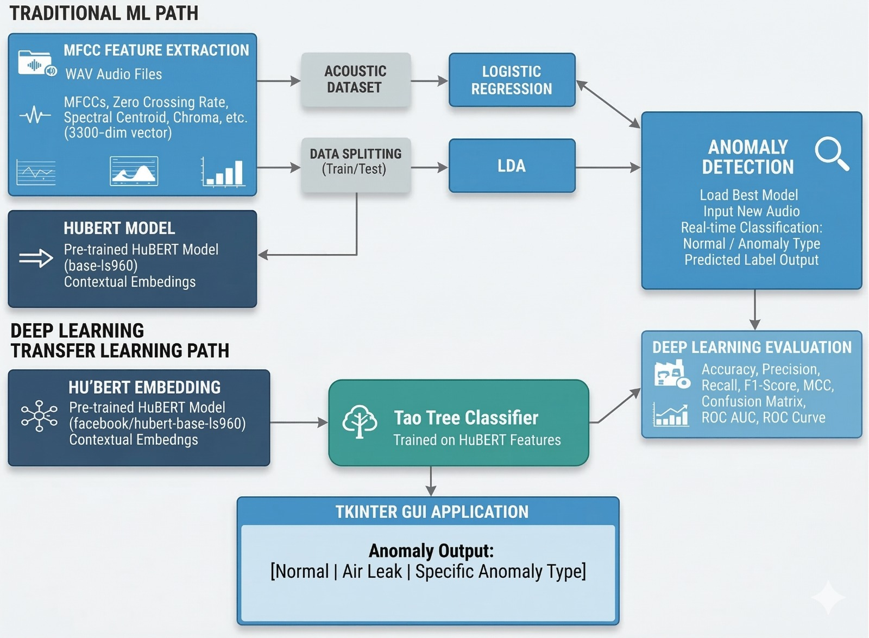
SYSTEM ARCHITECTURE

Slide 12
MODULES
Upload Dataset
Raw acoustic signals from industrial machinery are collected and uploaded.Audio files are validated and organized based on machine condition and labels.Proper data handling ensures reliable processing and analysis.
Feature Extraction (MFCC & HuBERT)
Acoustic features are extracted using MFCC and HuBERT techniques. MFCC captures low-level spectral and frequency characteristics of machine sounds. HuBERT extracts deep, high-level representations using a transformer-based model. The combined features improve robustness and anomaly detection performance..
Data Splitting
The dataset is divided into training, validation, and testing sets. Class balance and data integrity are maintained. This step ensures fair evaluation and generalization.

Slide 13
Model Building
A hybrid approach combines HuBERT features with tree-based classifiers.Models such as Random Forest or XGBoost are used for anomaly classification.The model learns to distinguish normal and abnormal machine sounds.
Performance Evaluation
Model performance is measured using Accuracy, Precision, Recall, and F1-Score.Confusion matrix and ROC-AUC are used for detailed analysis. Evaluation validates the effectiveness of the system.
Prediction on Test Data
The trained model is applied to unseen audio data. HuBERT features are extracted and classified. Output indicates normal or anomalous machine conditions.

Slide 14
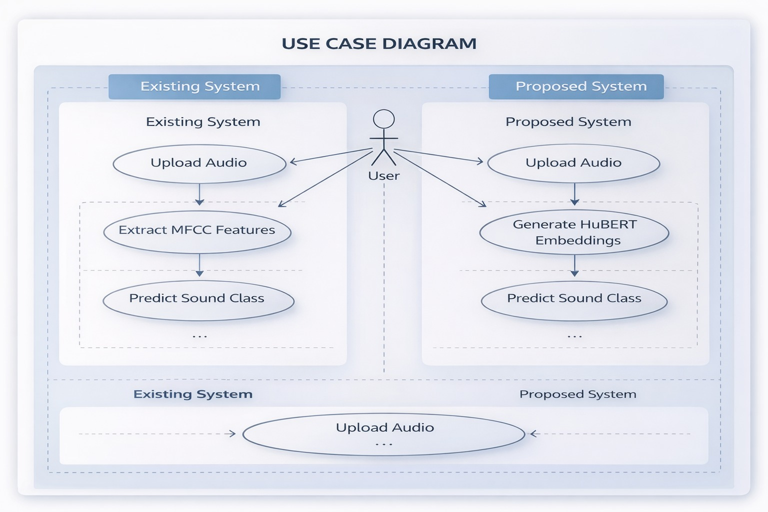
UML DIAGRAMS
Use Case Diagram

Slide 15
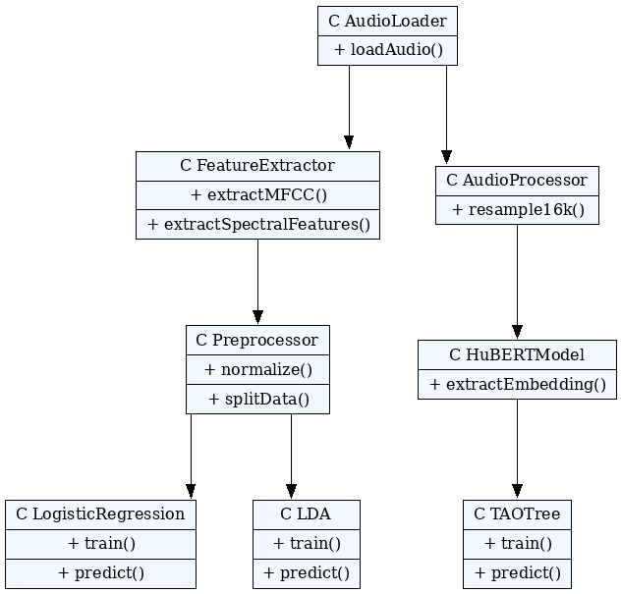
Class Diagram

Slide 16
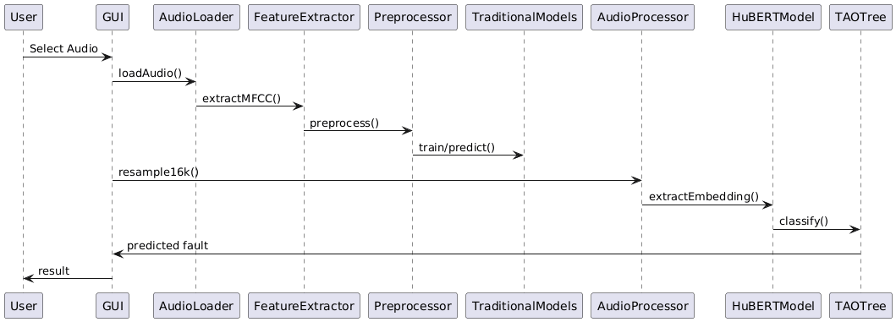
Sequence Diagram

Slide 17
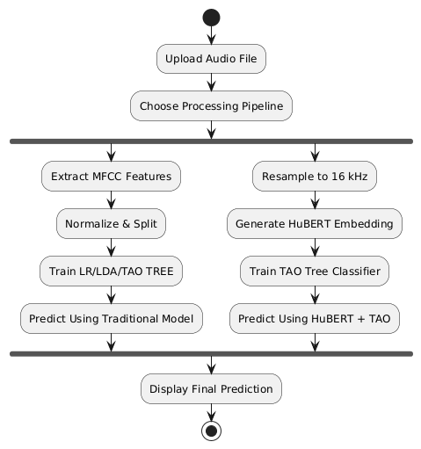
Activity Diagram

Slide 18
Source Code
audio, sr = librosa.load(audio_path, sr=None) mfccs = librosa.feature.mfcc(y=audio, sr=sr, n_mfcc=13) zero_crossings = librosa.feature.zero_crossing_rate(y=audio) spectral_centroid = librosa.feature.spectral_centroid(y=audio, sr=sr) chroma = librosa.feature.chroma_stft(y=audio, sr=sr) spectral_bandwidth = librosa.feature.spectral_bandwidth(y=audio, sr=sr) spectral_contrast = librosa.feature.spectral_contrast(y=audio, sr=sr) rms = librosa.feature.rms(y=audio) rolloff = librosa.feature.spectral_rolloff(y=audio, sr=sr, roll_percent=0.85) tonnetz = librosa.feature.tonnetz(y=audio, sr=sr) mel_spectrogram = librosa.feature.melspectrogram(y=audio, sr=sr) features = np.concatenate(( mfccs.flatten(), zero_crossings.flatten(), spectral_centroid.flatten(),

Slide 19
chroma.flatten(), spectral_bandwidth.flatten(), spectral_contrast.flatten(), rms.flatten(), rolloff.flatten(), tonnetz.flatten(), mel_spectrogram.flatten() ), axis=0) max_length = 3000 if len(features) < max_length: features = np.pad(features, (0, max_length - len(features)), mode='constant') else: features = features[:max_length] X_list.append(features) label_name = os.path.basename(root) Y_list.append(categories.index(label_name))

Slide 20
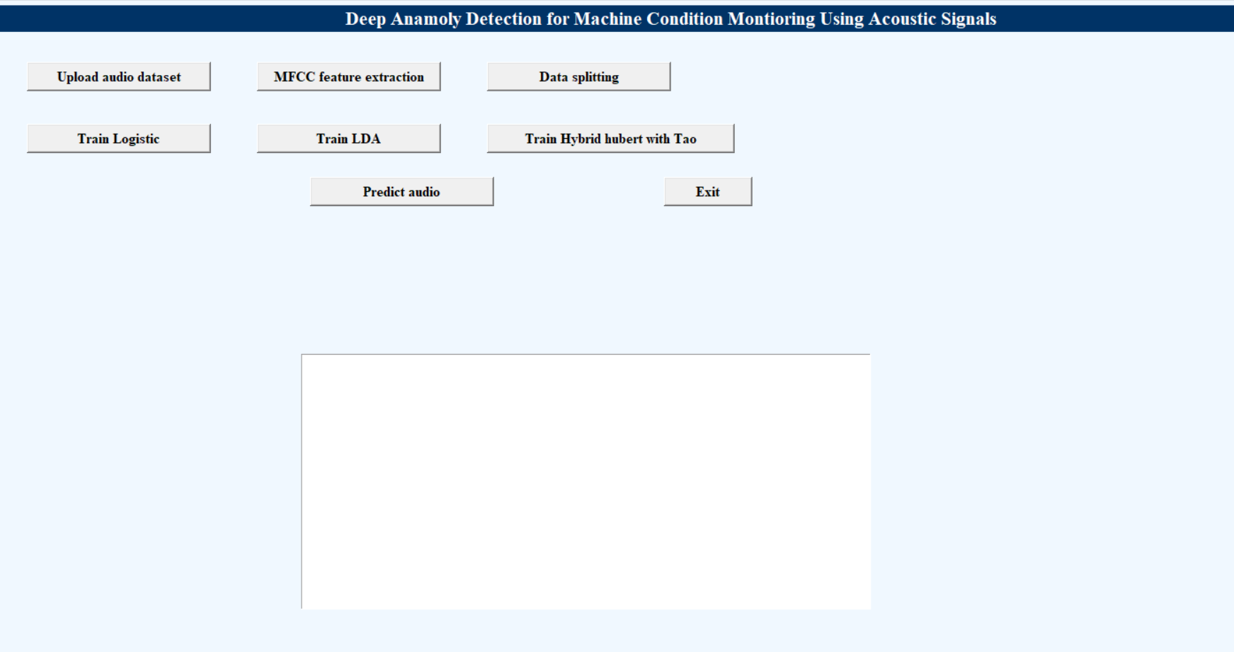
Results
Main GUI Interface of the Acoustic Fault Detection System.

Slide 21
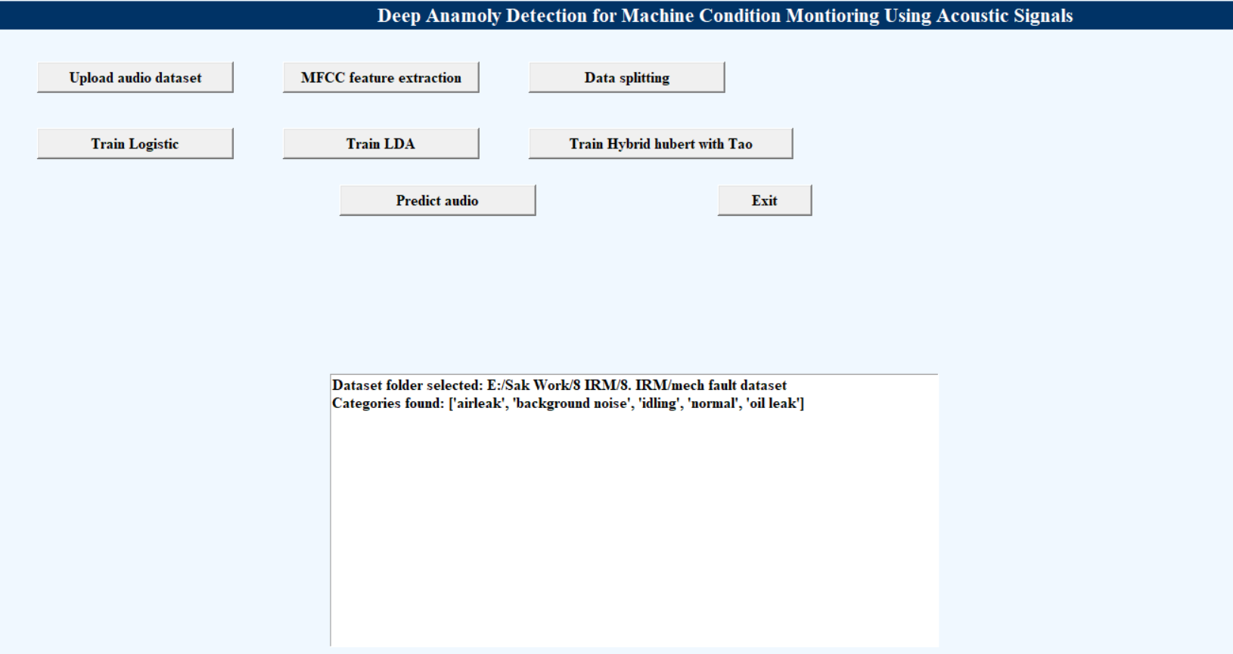
Dataset Upload Confirmation and Category Detection Display

Slide 22
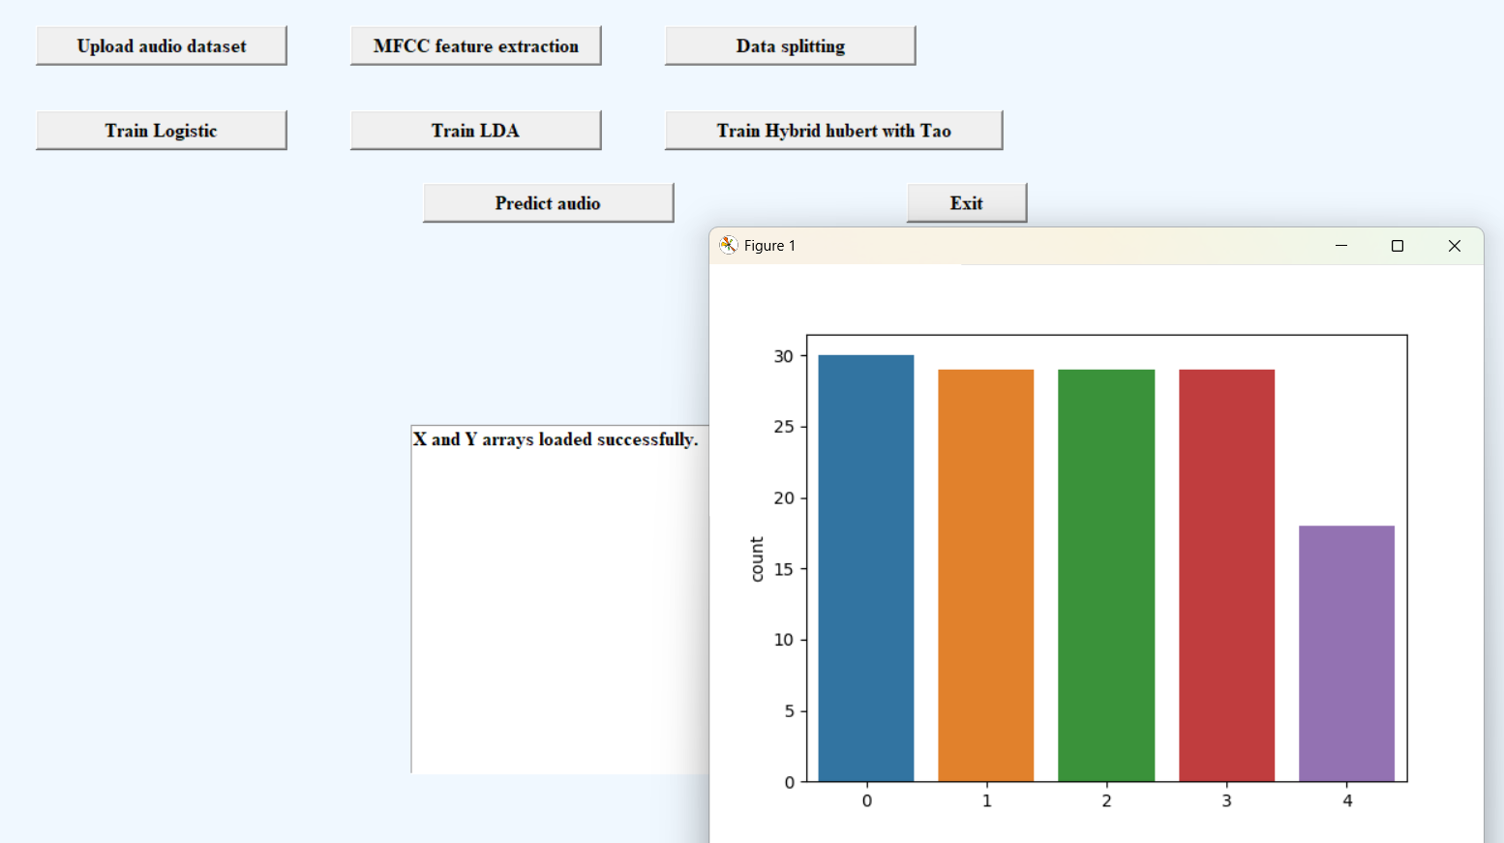
Loaded MFCC Feature Arrays (X and Y) with Class Distribution Plot.

Slide 23
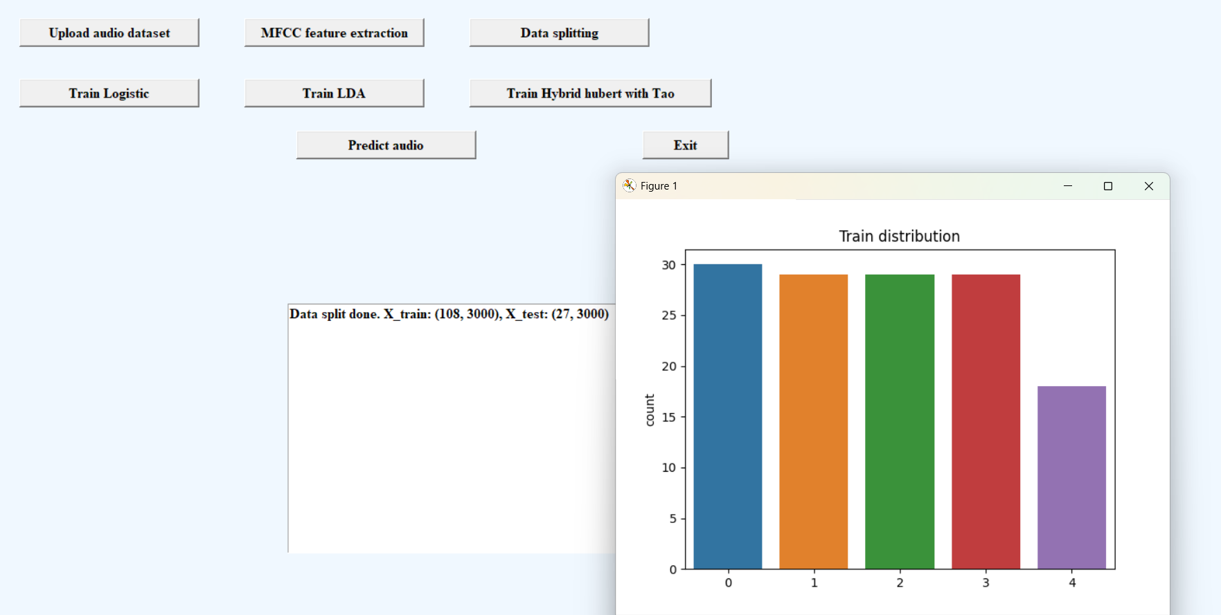
Train–Test Split Distribution for Acoustic Fault Dataset.

Slide 24
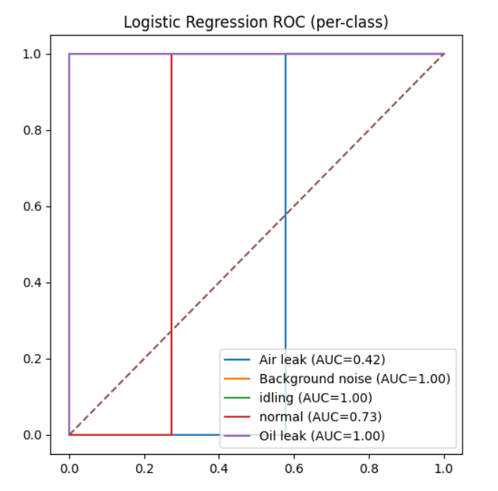
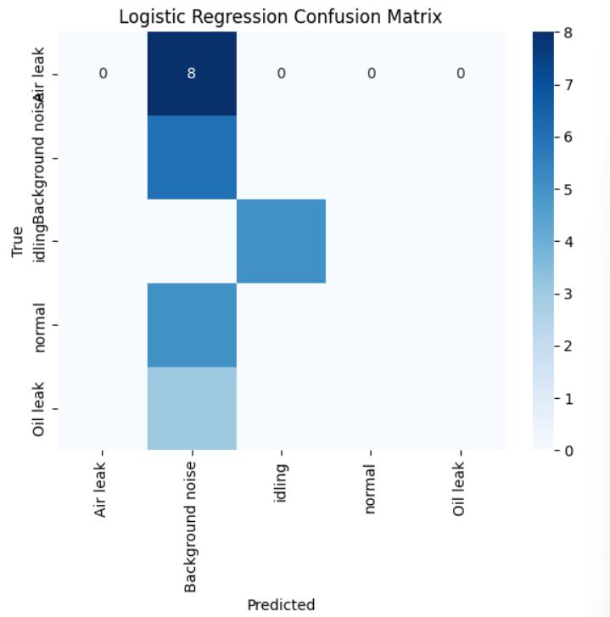
Logistic Regression – Confusion Matrix & ROC Curve

Slide 25
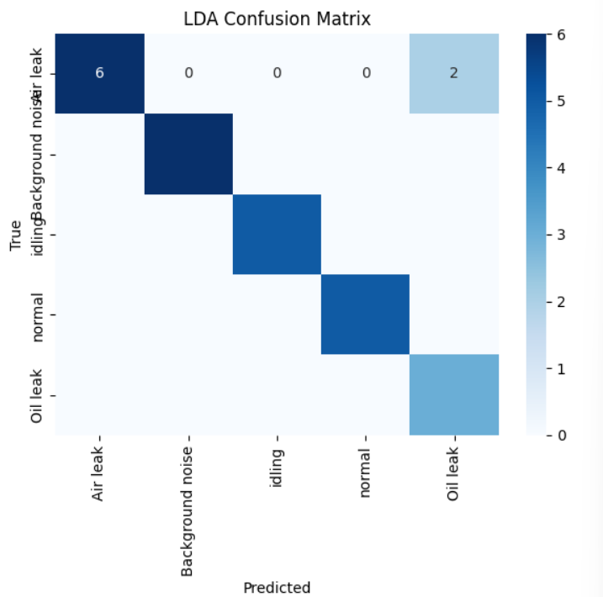
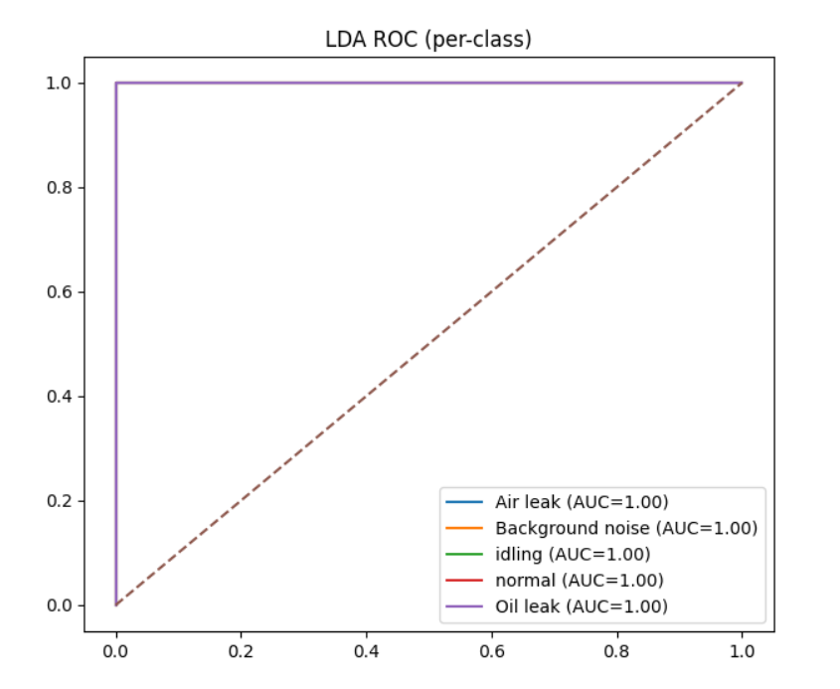
Linear Discriminant Analysis (LDA) – Confusion Matrix & ROC Curve

Slide 26
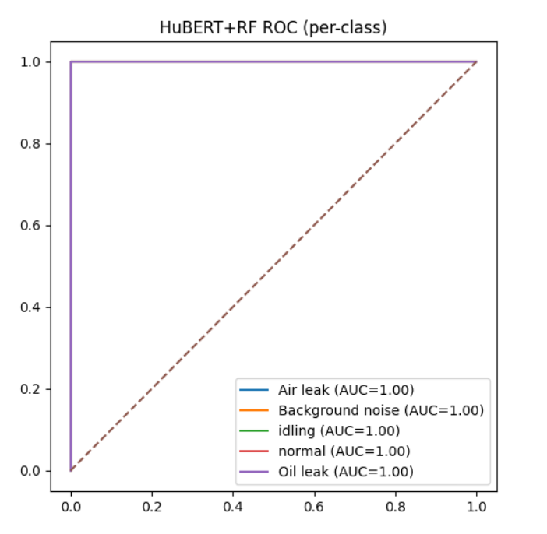
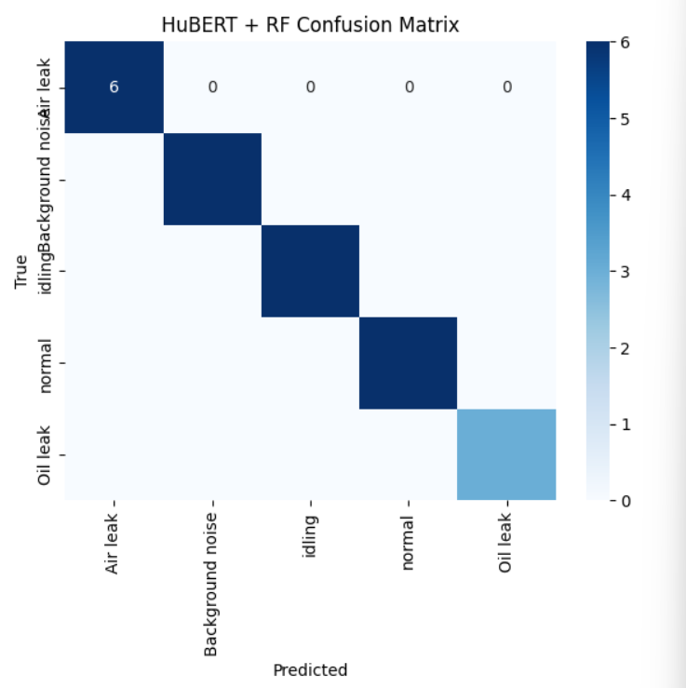
HUBERT + Tao Tree – Confusion Matrix &ROC curve

Slide 27
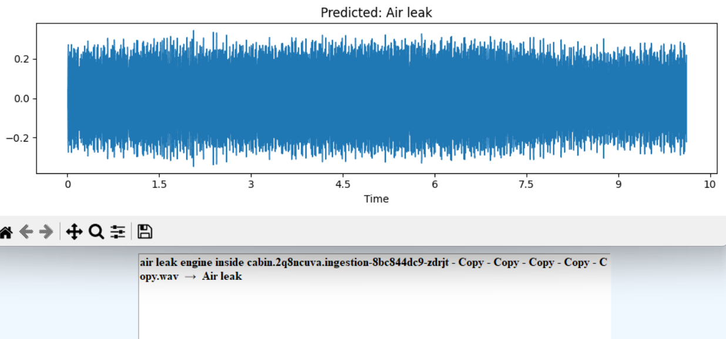
Predicted Output Waveform for Audio Sample: Air Leak.

Slide 28
Conclusion & Future Enhancement
The project proposed an intelligent acoustic anomaly detection system for industrial machinery.
By combining HuBERT deep audio embeddings with tree-based machine learning models, the system improves fault detection accuracy.
The model effectively identifies subtle acoustic differences in machine sounds.
Future Enhancements
Integration with IoT sensors and cloud platforms for real-time industrial monitoring.
Deployment as a web-based or mobile monitoring system for remote access.
Implementation of deep learning models such as CNNs or Transformers for improved generalization.

Slide 29
References
Foggia, P.; Petkov, N.; Saggese, A.; Strisciuglio, N.; Vento, M. Audio Surveillance of Roads: A System for Detecting Anomalous Sounds. IEEE Trans. ITS 2019, 17, 279–288.
Ntalampiras, S.; Potamitis, I.; Fakotakis, N. Probabilistic Novelty Detection for Acoustic Surveillance Under Real-World Conditions. IEEE Trans. Multimed. 2021, 13, 713–719.
Koizumi, Y.; Saito, S.; Uematsu, H.; Harada, N. Optimizing Acoustic Feature Extractor for Anomalous Sound Detection Based on NeymanPearson Lemma. In Proceedings of the 2017 25th European Signal Processing Conference (EUSIPCO), Kos, Greece, 28 August–2 September 2017.
Wang, Y.; Zheng, Y.; Zhang, Y.; Xie, Y.; Xu, S.; Hu, Y.; He, L. Unsupervised Anomalous Sound Detection for Machine Condition Monitoring Using Classification-Based Methods. Appl. Sci. 2021, 11, 11128. https://doi.org/10.3390/app112311128

Slide 30
GitHub Link
https://github.com/bavithalalapudi04-bit/hubert-driven-hybrid-tree-learning-for-industrial-acoustic-anomaly-detection

Slide 31


